Slide 1


Slide 2
Big Data

Slide 3
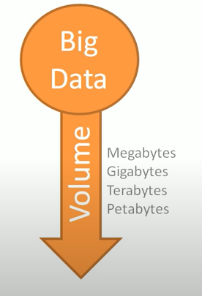
How Big is Big Data ?

Slide 4
Gartner’s “big data”
Big data is high-volume, high-velocity and/or high-variety information assets that demand cost-effective, innovative forms of information processing that enable enhanced insight, decision making, and process automation.

Slide 5
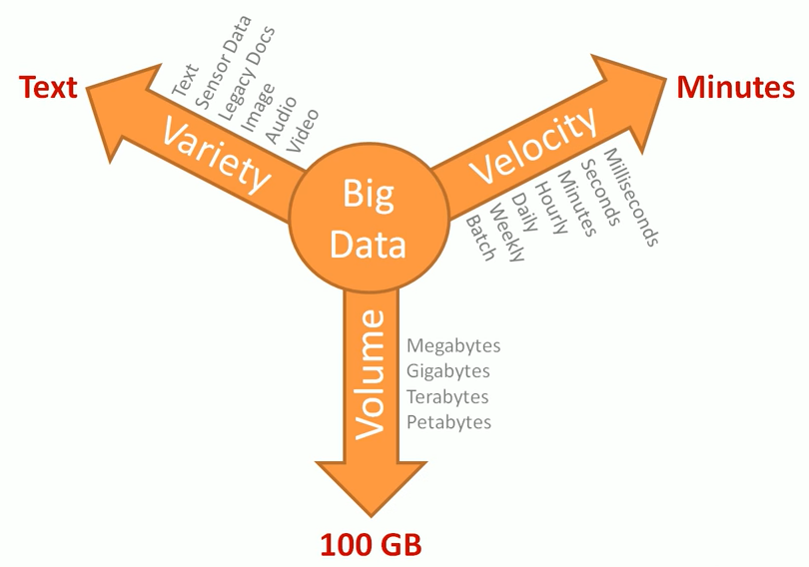

Slide 6
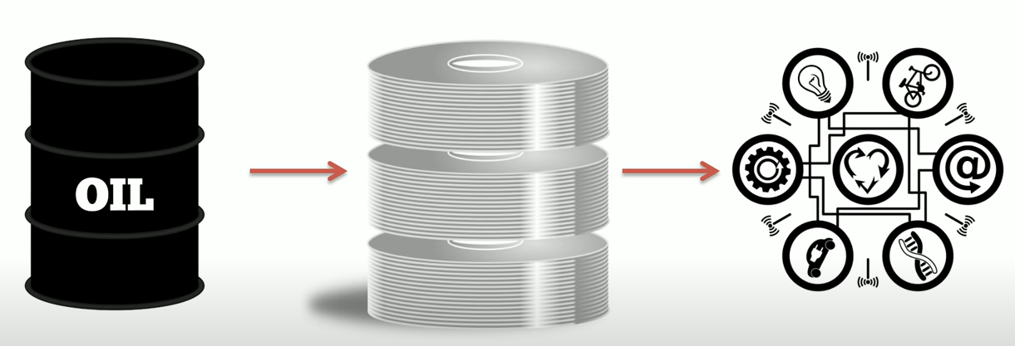
History of Hadoop
It all began with wide usage of world wide web
Search engines like google , yahoo, youtube , and amazon were the first one to face big data problem
Data is like oil , almost every organization rely on data for insight and use them for decision making

Slide 7
Abundance: Data, like oil, is abundant in today's digital world. With the proliferation of digital devices, sensors, and online platforms, there is a massive amount of data being generated every second
Extraction: Extracting value from data requires effort, just like extracting oil from the ground.
Refinement: Raw data needs to be refined and transformed into useful information, just as crude oil goes through refining processes to produce valuable products
Value Creation: Data can fuel innovation and drive business growth. By analyzing data, organizations can gain valuable insights into customer behavior, market trends, operational efficiency, and more, leading to improved decision-making and competitive advantages.
Security and Privacy Concerns: Like oil, data needs to be protected.

Slide 8
Hadoop was one of the first toolset to deal with big data!
Do you know any other ?

Slide 9
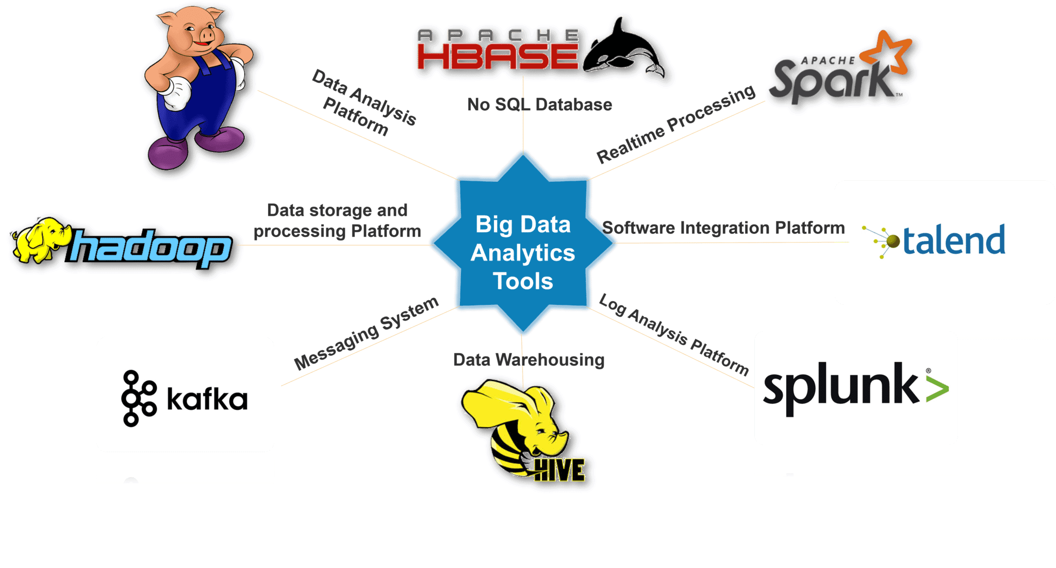

Slide 10

Where did it come from ?

Slide 11
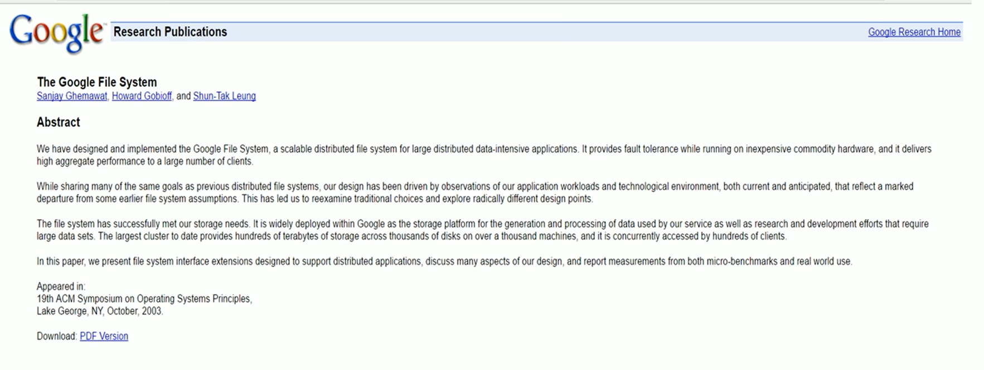
Its origin was the Google File System paper, published by Google.

Slide 12
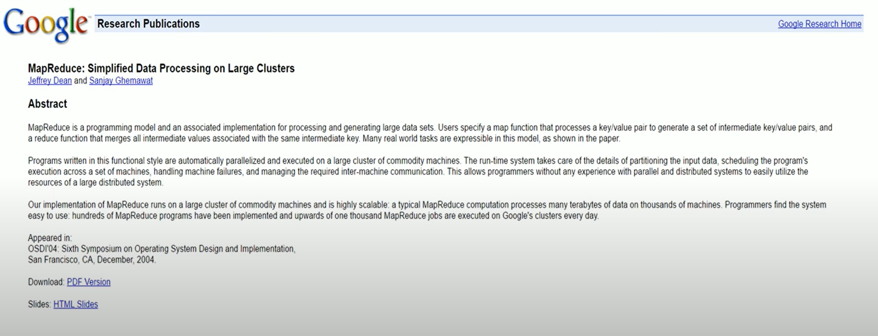

Slide 13
In 2002, Doug Cutting and Mike Cafarella started to work on a project, Apache Nutch. It is an open source web crawler software project.
While working on Apache Nutch, they were dealing with big data. To store that data they have to spend a lot of costs which becomes the consequence of that project. This problem becomes one of the important reason for the emergence of Hadoop.
In 2003, Google introduced a file system known as GFS (Google file system). It is a proprietary distributed file system developed to provide efficient access to data.
In 2004, Google released a white paper on Map Reduce. This technique simplifies the data processing on large clusters.
In 2006, introduces a new project Hadoop with a file system known as HDFS (Hadoop Distributed File System)
Doug Cutting gave named his project Hadoop after his son's toy elephant.
In 2007, Yahoo runs two clusters of 1000 machines.
In 2008, Hadoop became the fastest system to sort 1 terabyte of data on a 900 node cluster within 209 seconds.
In 2013, Hadoop 2.2 was released
In 2017, Hadoop 3.0 was released

Slide 14
two major components of Hadoop are:
HDFS (Hadoop Distributed File System)
Hadoop MapReduce
Hadoop MapReduce is a programming model that facilitates the processing of Big Data that is stored on HDFS.
Hadoop MapReduce relies on the resources of multiple interconnected computers to handle large amounts of both structured and unstructured data.
Before the introduction of Apache Spark and other Big Data Frameworks, Hadoop MapReduce was the only player in Big Data Processing

Slide 15
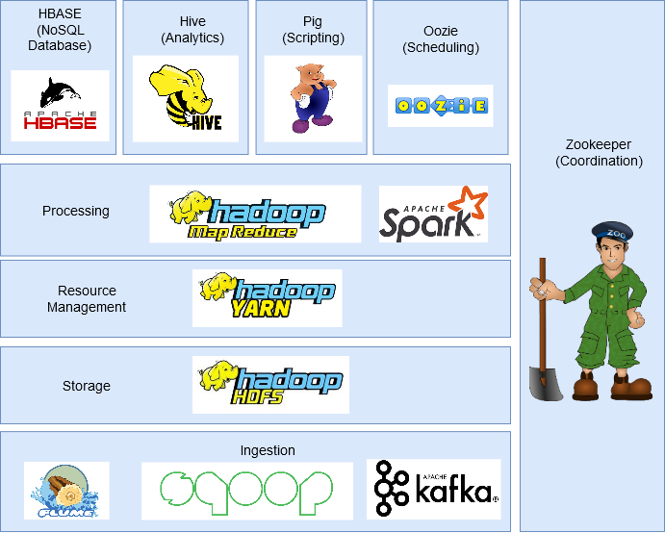
Hadoop Core
HDFS
Map Reduce
YARN

Slide 16
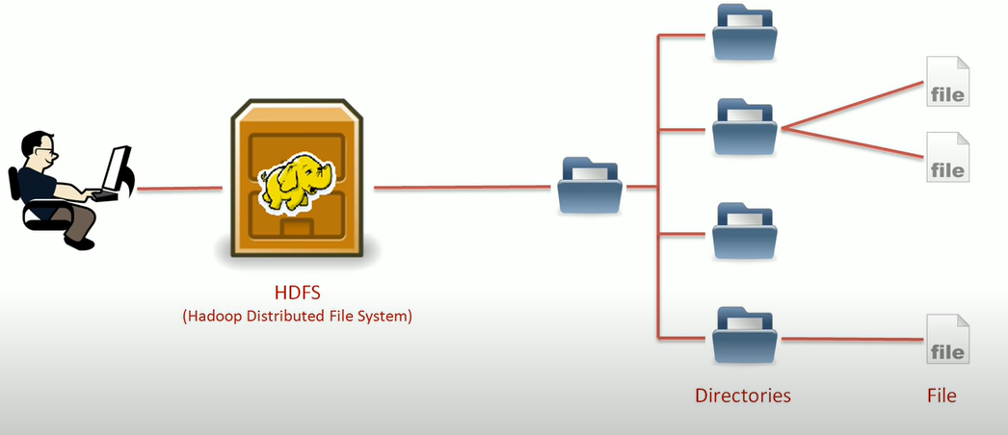
HDFS

Slide 17
HDFS Features
Distributed
Scalable
Cost Effective
Fault Tolerant
High Throughput

Slide 18
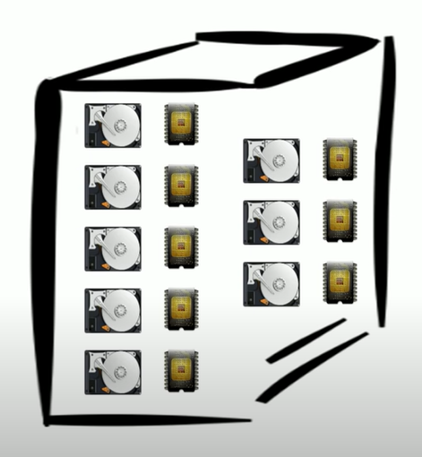
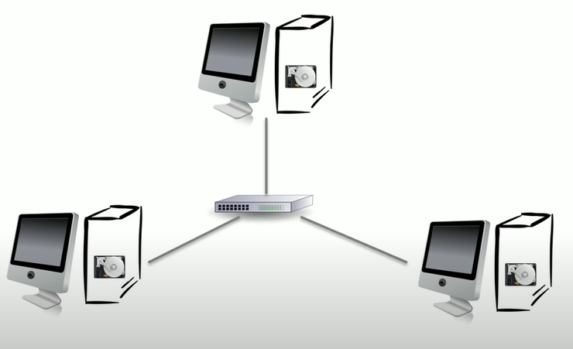
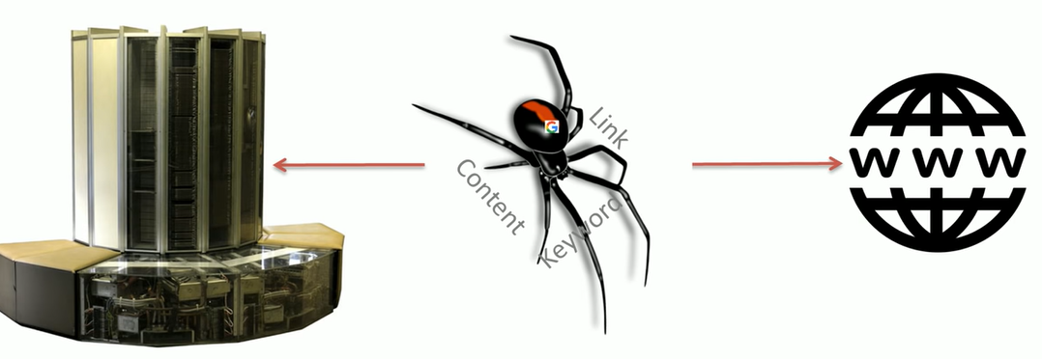
Need for Distributed File System
Vertical Scaling
Search Engine Crawler
To handle such data , lets use same approach
Network Approach
Horizontal Scaling

Slide 19
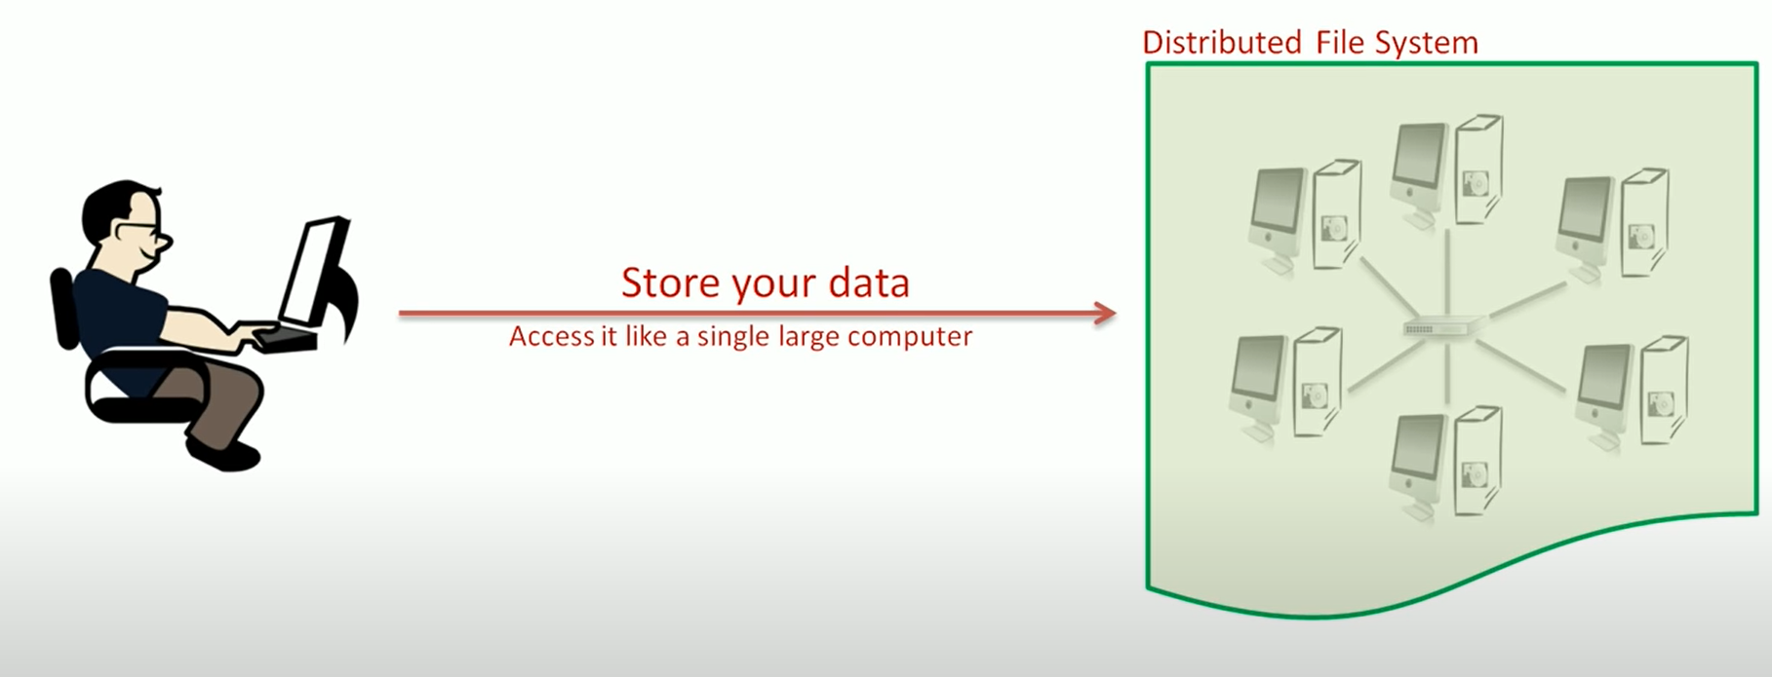
Horizontal Scaling (HDFS)

Slide 20
HDFS Features
Distributed
Scalable
Cost Effective (start from single machine and then scale up horizontally) . Commodity Hardware
Fault Tolerant (through replication , discussed later )
High Throughput (Latency , Throughput)
Latency: Time to get the first record
Throughput : Number of records processed per unit of time
HDFS have high throughput but high latency

Slide 21
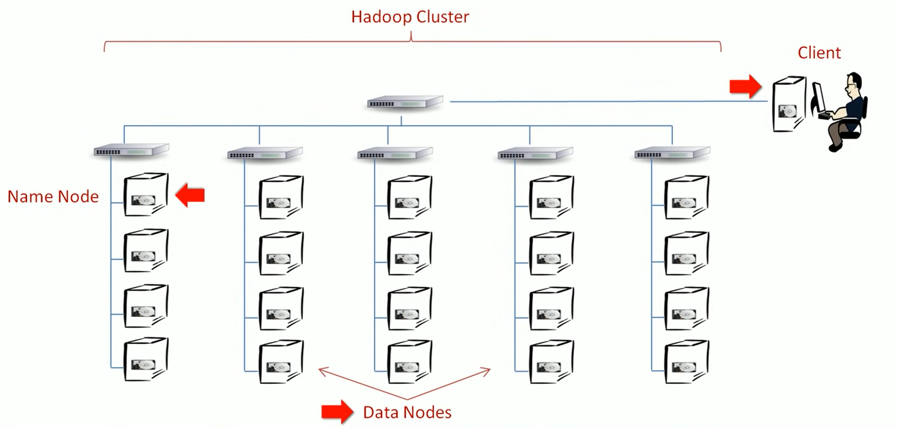
Hadoop Cluster

Slide 22
Name Node : Manage File system namespace ( store and manages names of directories and files)
Data Node: Manage Data

Slide 23
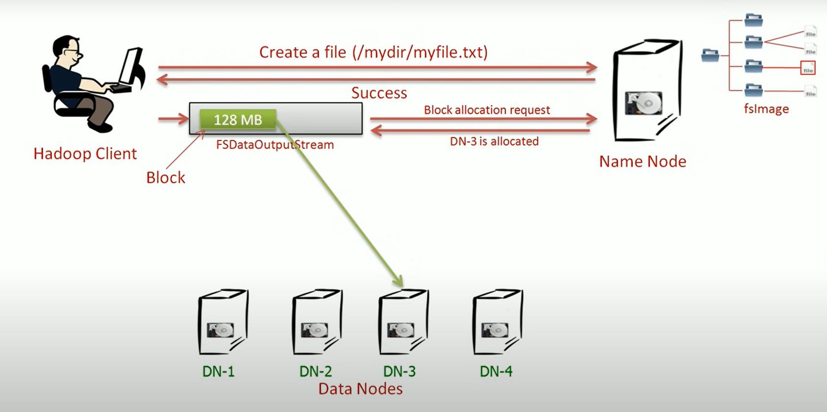

Slide 24
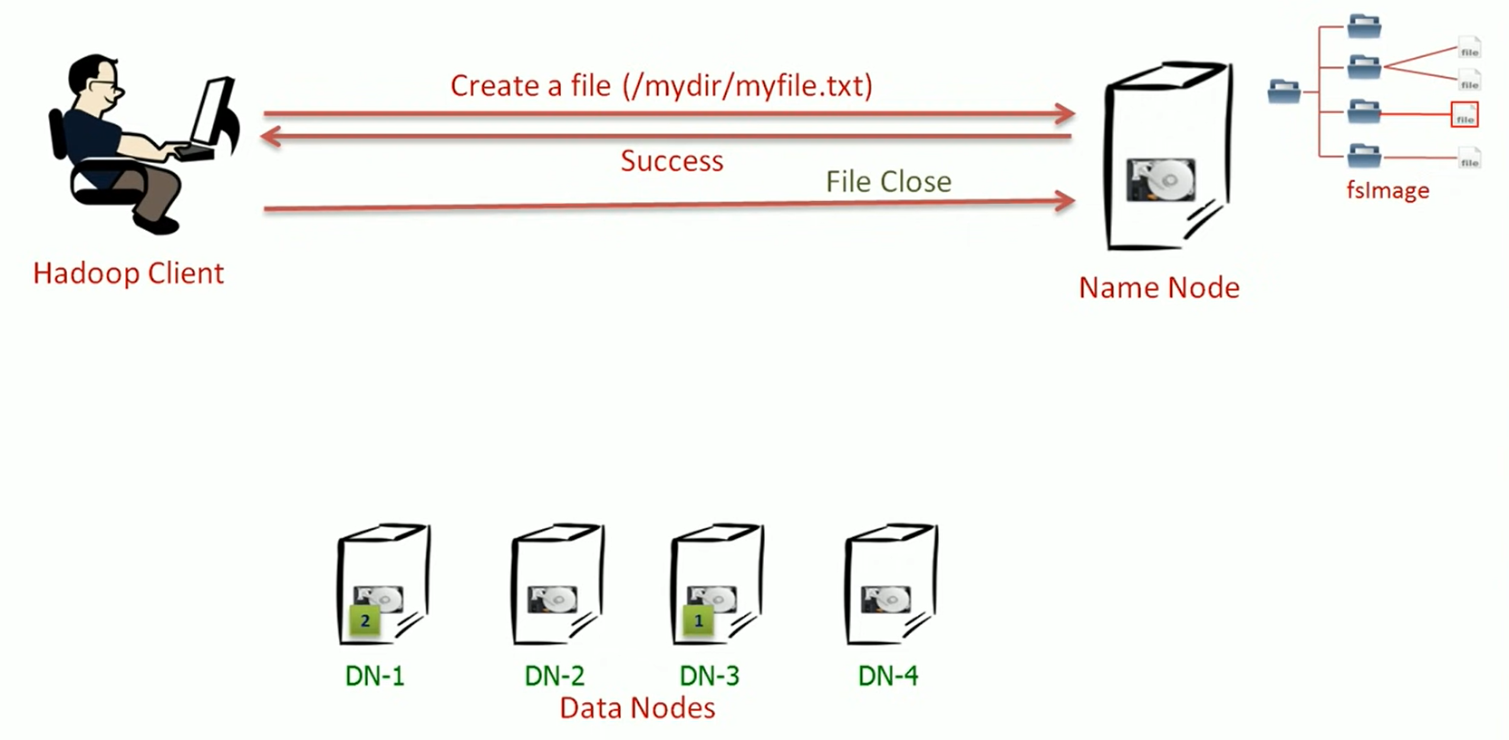

Slide 25
Takeaways till now
Master/Slave architecture
Single Name Node (Master)
One or more Data Nodes (Slaves)
NN manages and regulates FS namespace
All client interactions start with NN
DN stores file data as Blocks
DN sends heartbeat and block report to NN
File is broken into Blocks and stored on DN
NN maintains file to block mapping, location, order of blocks and other metadata.
Default block size is 128 MB
You can change block size for a file
Client directly interacts with DN for reading/writing blocks
Client buffers data locally to provide streaming read/write
NN and DN can be installed on single machine to create a single node cluster for learning purpose

Slide 26
Fault Tolerance

Slide 27
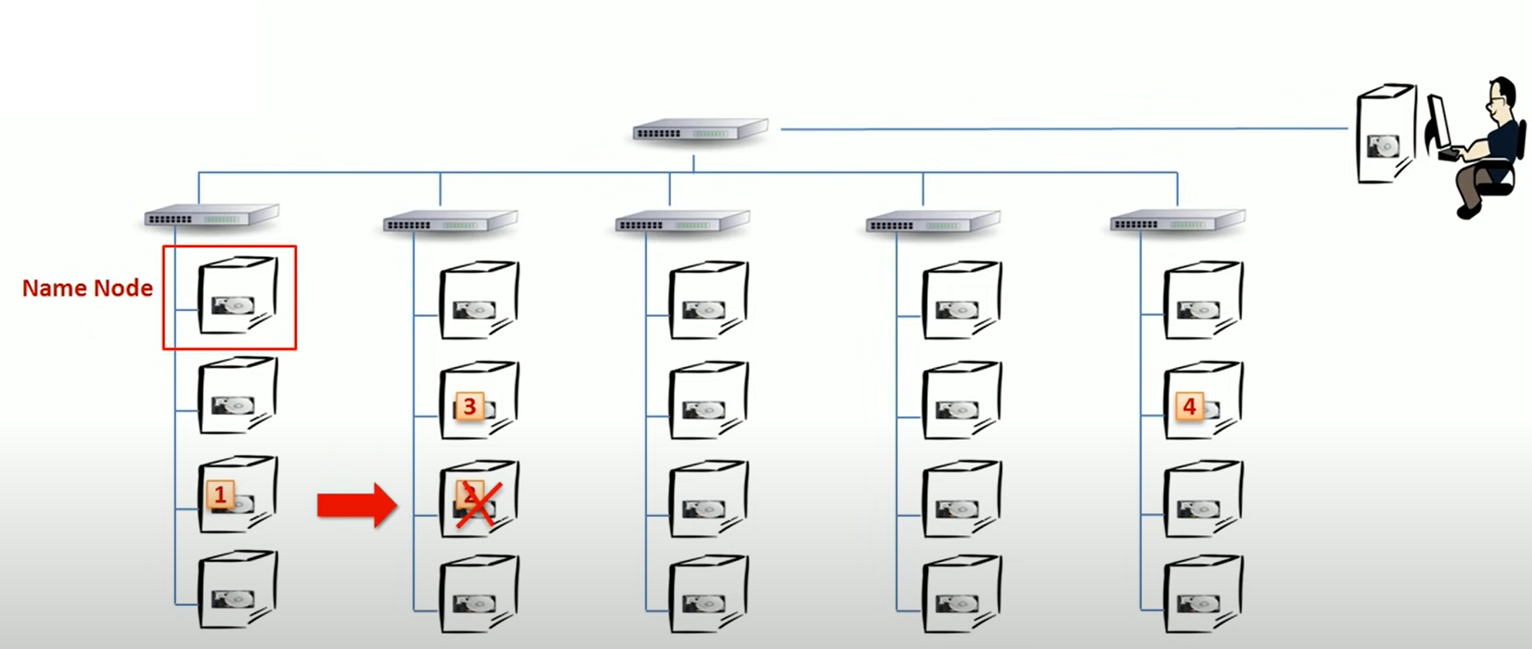

Slide 28
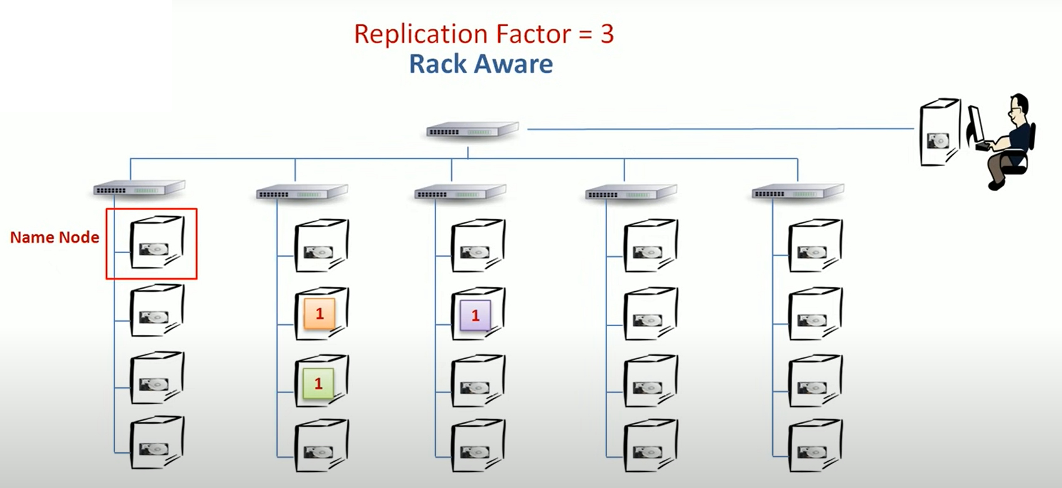

Slide 29

Replication is Expensive!
Replication factor of 3 means that 1/3rd of your storage will be reduced
Hadoop 2.0 introduced storage policies to reduce such cost
Hadoop 3.0 introduced erasure coding (an alternate to replication)
https://hadoop.apache.org/docs/stable/hadoop-project-dist/hadoop-hdfs/HDFSErasureCoding.html

Slide 30

High Availability
Do you remember SLA ?
Uptime
Every organization desire 99.99% uptime

Slide 31
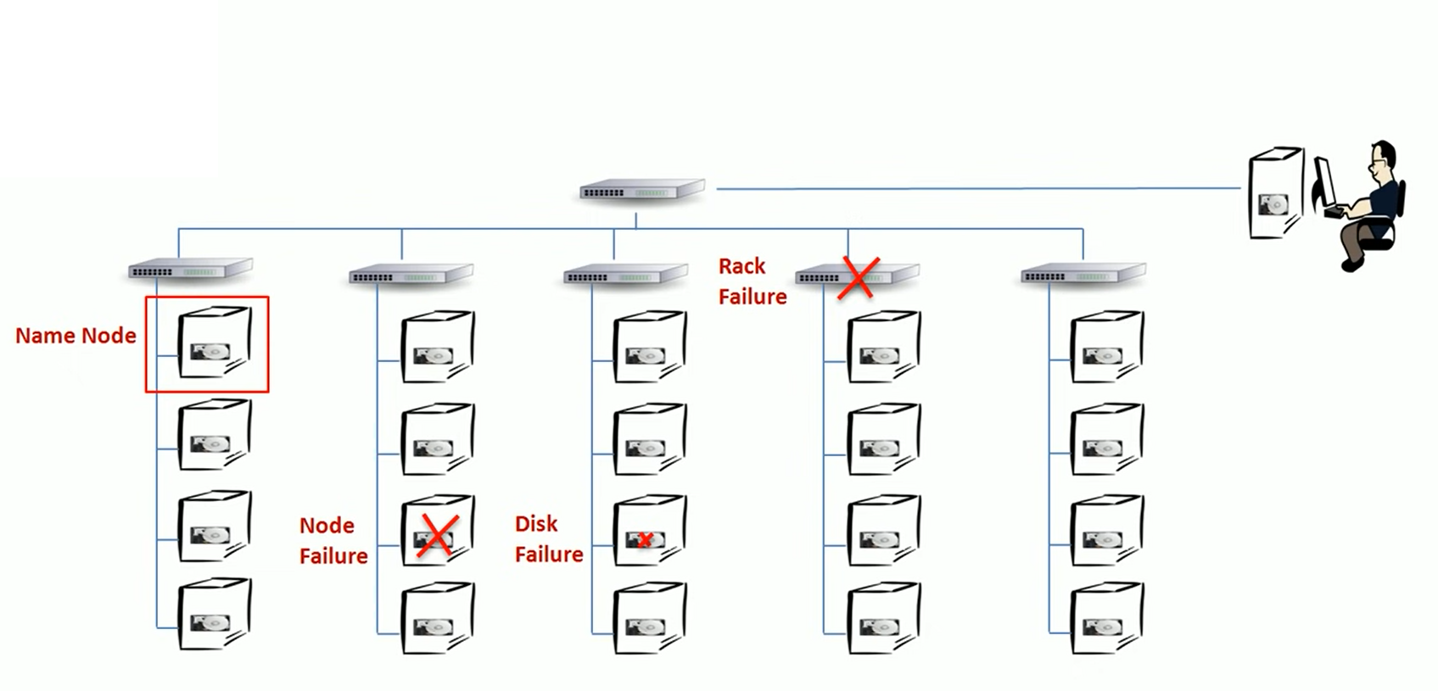
Through replication we can handle Data Node Failure

Slide 32
But what will happen if Name Node fails ?

Slide 33
How to Protect NN failure ?
Backup Following things:
HDFS Namespace Information
Stand-by name node

Slide 34
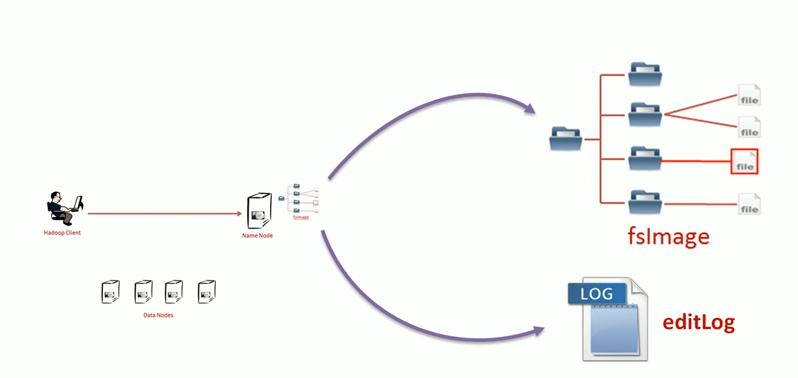
HDFS Namespace Information

Slide 35
